Slide 1
mHealth in Uganda
National Leadership and USAID‘s role
Daryl Martyris, Health Officer, USAID/Uganda
dmartyris@usaid.gov

Slide 2
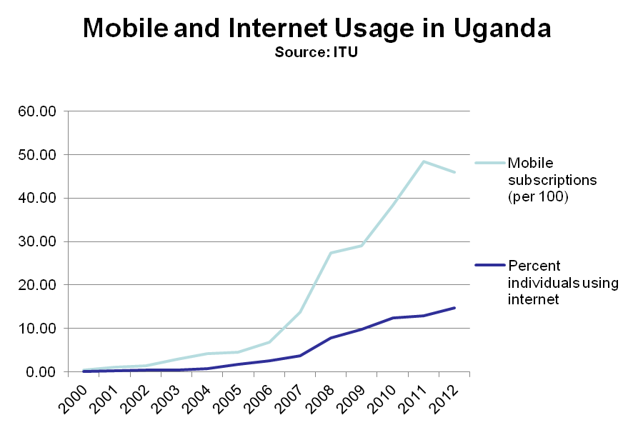
mHealth and Uganda
mHealth is the practice of medicine and public health, supported by mobile devices. (eHealth refers to all ICT, not just mobile) Source: Wikipedia
Notes:
The access.mobile team, led by Founder Kaakpema Yelpaala (KP), an American social entrepreneur of Ghanaian descent, has designed a mobile data collection and analytics system based on an SMS platform to electronically track priority health indicators, monitor stock levels of antiretroviral drugs and support organizations in understanding their data. This m-Health initiative, which uses full keyboard feature phones to send and receive information, has been rapidly scaled up for piloting in 70 health clinics in just three months. It was determined by HIPS that just over 30 of their clinics, mainly urban sites, had sufficient connectivity to send their reports electronically, though the overwhelming majority were not in that position.
But not only is access.mobile working to develop scalable technologies for improved communications in the region, the model of development is one based on local ownership and long-term sustainability. According to KP, “Uganda particularly is a place with a ton of talent in the technology sector. All of our employees in Uganda are from Uganda. They’re trained in mobile technology, computer science, and medicine. They’re the linchpin to our company’s success because they understand the context. They understand how Ugandans think about technology. It’s when you blend a local team like that with a global team like ours – that’s when you get innovation.”

Slide 3
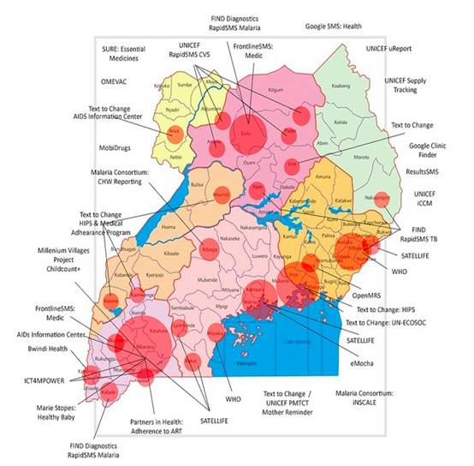
Background
Proliferation of pilots, but no scale-up
eHealth managed by same MOH unit that overseas SI – poor coordination
Moratorium on new eHealth activities in public sector till eHealth policy, strategy and roadmap developed
Only provisionally MOH approved systems – DHIS2, iHRIS, mTRAC
Notes:
Implemented by Cardno Emerging markets USA, Ltd. Partners are: Jhuccp/ obrien associates international, mildmay uganda, uhmg and the straight talk foundation

Slide 4
Linking eHealth to Strengthening Health Systems
eHealth Pillars
eHealth Outcome
Domains
Leadership and Governance for eHealth
Health System
Outcomes
Organization and management of Health Service Improved planning,
Health System Goals
Legal and Regulatory Framework for eHealth
Coverage
Improved functioning of all health information systems
Improved Health
eInfrastructure, standards and Systems
Improved safety and quality of care
Responsiveness
Quality
Investment for eHealth
Increasing demand and reducing barriers to accessing health services
Social and Financial Risk Protection
Access
Human Resources for eHealth
Improving health research, knowledge networks and learning
Improved Efficiency
Safety
eHealth Services and Applications
Optimization of human resources for health.
Developed by WHO Uganda - Adapted from Everybody’s Business: Strengthening Health Systems to improve Health Outcomes:
WHO’s Framework for Action (2007) and the WHO ITU National eHealth Strategy ToolKit (2012)
Notes:
Strategy identifies key actions necessary to implement each of the pillars, and groups those actions into implementation phases

Slide 5
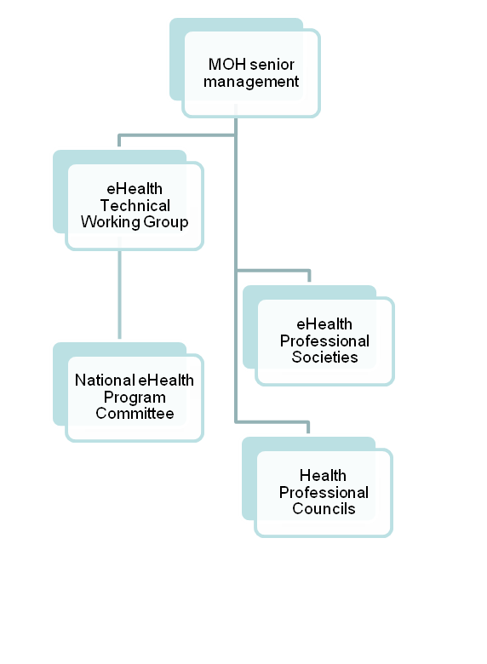
eHealth Governance Structure
eHealth TWG
  Technical body within the MOH structures with multi stakeholder representation (HDPs, and ad-hoc IPs)
  Oversees all e-health projects and programmes in the country, and is responsible for their efficient coordination.
The National eHealth Program Committee
  Develops individual activity plans that are aligned to the implementation plan of the National Strategic Plan for approval by MOH organs before implementation
  Encourages co-ordination and integration of the individual eHealth projects/programs as part of the overall National eHealth Program
Notes:
The access.mobile team, led by Founder Kaakpema Yelpaala (KP), an American social entrepreneur of Ghanaian descent, has designed a mobile data collection and analytics system based on an SMS platform to electronically track priority health indicators, monitor stock levels of antiretroviral drugs and support organizations in understanding their data. This m-Health initiative, which uses full keyboard feature phones to send and receive information, has been rapidly scaled up for piloting in 70 health clinics in just three months. It was determined by HIPS that just over 30 of their clinics, mainly urban sites, had sufficient connectivity to send their reports electronically, though the overwhelming majority were not in that position.
But not only is access.mobile working to develop scalable technologies for improved communications in the region, the model of development is one based on local ownership and long-term sustainability. According to KP, “Uganda particularly is a place with a ton of talent in the technology sector. All of our employees in Uganda are from Uganda. They’re trained in mobile technology, computer science, and medicine. They’re the linchpin to our company’s success because they understand the context. They understand how Ugandans think about technology. It’s when you blend a local team like that with a global team like ours – that’s when you get innovation.”

Slide 6
eHealth Roadmap
Criteria for software selection developed, software solutions will be selected after stakeholder workshop
Draft criteria for approving new eHealth activities
  Strategic fit with National Agenda: Compatible with National eHealth system (data exchange or mandatory system use?)
  Comprehensive design: Meet all needs at a particular SD-level?
  Implementation readiness: Timeline, cost of development, local capacity?
  Sustainability: Funding linked to project?
Notes:
The access.mobile team, led by Founder Kaakpema Yelpaala (KP), an American social entrepreneur of Ghanaian descent, has designed a mobile data collection and analytics system based on an SMS platform to electronically track priority health indicators, monitor stock levels of antiretroviral drugs and support organizations in understanding their data. This m-Health initiative, which uses full keyboard feature phones to send and receive information, has been rapidly scaled up for piloting in 70 health clinics in just three months. It was determined by HIPS that just over 30 of their clinics, mainly urban sites, had sufficient connectivity to send their reports electronically, though the overwhelming majority were not in that position.
But not only is access.mobile working to develop scalable technologies for improved communications in the region, the model of development is one based on local ownership and long-term sustainability. According to KP, “Uganda particularly is a place with a ton of talent in the technology sector. All of our employees in Uganda are from Uganda. They’re trained in mobile technology, computer science, and medicine. They’re the linchpin to our company’s success because they understand the context. They understand how Ugandans think about technology. It’s when you blend a local team like that with a global team like ours – that’s when you get innovation.”

Slide 7
Next Steps
Complete eHealth infrastructure improvements at MOH
Finalize Roadmap (including criteria) and lift moratorium
Determine total cost of ownership Seek funding
Develop National eHealth system
Pilot & Evaluate system
Roll-out system to Districts
Notes:
The access.mobile team, led by Founder Kaakpema Yelpaala (KP), an American social entrepreneur of Ghanaian descent, has designed a mobile data collection and analytics system based on an SMS platform to electronically track priority health indicators, monitor stock levels of antiretroviral drugs and support organizations in understanding their data. This m-Health initiative, which uses full keyboard feature phones to send and receive information, has been rapidly scaled up for piloting in 70 health clinics in just three months. It was determined by HIPS that just over 30 of their clinics, mainly urban sites, had sufficient connectivity to send their reports electronically, though the overwhelming majority were not in that position.
But not only is access.mobile working to develop scalable technologies for improved communications in the region, the model of development is one based on local ownership and long-term sustainability. According to KP, “Uganda particularly is a place with a ton of talent in the technology sector. All of our employees in Uganda are from Uganda. They’re trained in mobile technology, computer science, and medicine. They’re the linchpin to our company’s success because they understand the context. They understand how Ugandans think about technology. It’s when you blend a local team like that with a global team like ours – that’s when you get innovation.”

Slide 8
Current USAID Uganda supported mHealth Activities
Notes:
The access.mobile team, led by Founder Kaakpema Yelpaala (KP), an American social entrepreneur of Ghanaian descent, has designed a mobile data collection and analytics system based on an SMS platform to electronically track priority health indicators, monitor stock levels of antiretroviral drugs and support organizations in understanding their data. This m-Health initiative, which uses full keyboard feature phones to send and receive information, has been rapidly scaled up for piloting in 70 health clinics in just three months. It was determined by HIPS that just over 30 of their clinics, mainly urban sites, had sufficient connectivity to send their reports electronically, though the overwhelming majority were not in that position.
But not only is access.mobile working to develop scalable technologies for improved communications in the region, the model of development is one based on local ownership and long-term sustainability. According to KP, “Uganda particularly is a place with a ton of talent in the technology sector. All of our employees in Uganda are from Uganda. They’re trained in mobile technology, computer science, and medicine. They’re the linchpin to our company’s success because they understand the context. They understand how Ugandans think about technology. It’s when you blend a local team like that with a global team like ours – that’s when you get innovation.”

Slide 9
mTRAC
UNICEF developed, DFID/WHO funded,RapidSMS system
Uses personal phones to send weekly SMS messages with surveillance and commodity stock data (stock-out and impending stock-outs) to a toll-free shortcode
Assists NMS and Districts to manage ACT and RDT stocks more effectively through timely re-ordering and re-distribution
Too early to tell if showing results
Issues - Low reporting rates, lack of resources for re-distribution of commodities, multiple eHealth systems confusing
Being integrated into HMIS system (DHIS-2) – this will give partners almost real-time access to data
Anonymous SMS hotline, UReport polling application use same platform

Slide 10
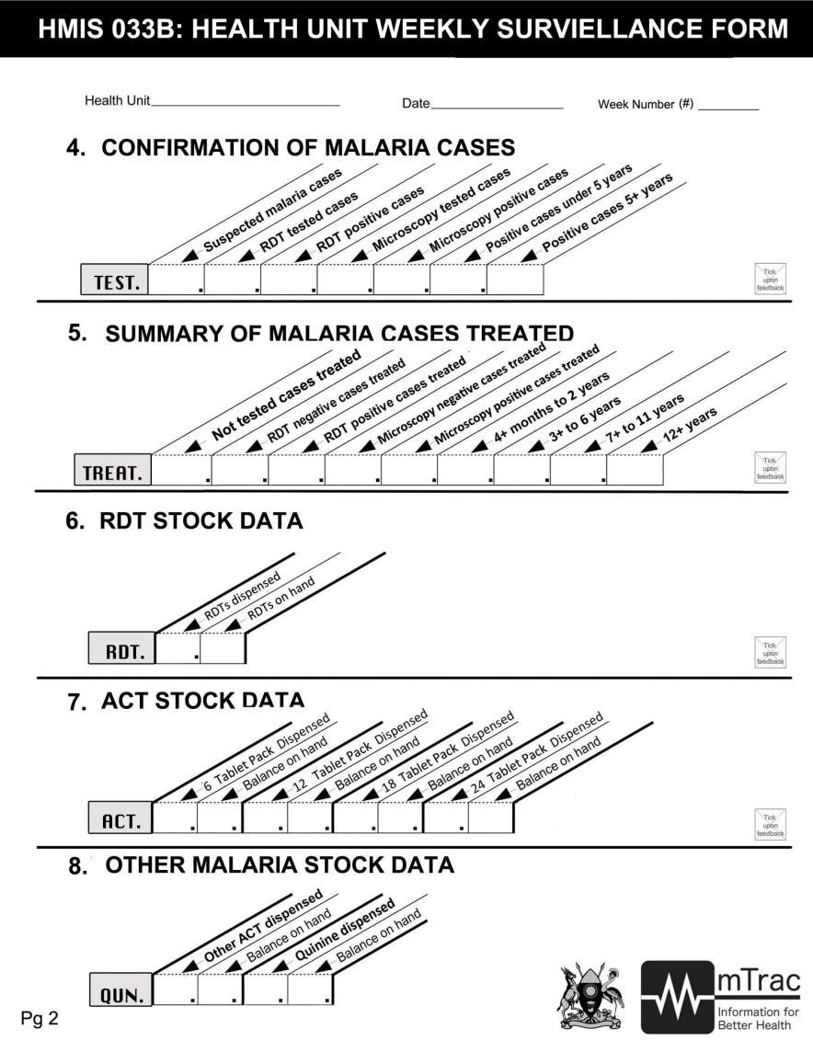
MTRAC - Stop Malaria Project, STAR-SW
Reminds District Health officials to follow up with facilities to submit weekly data, and to redistribute drugs
Will start refresher training of HWs on using mTRAC (part of clinical audits, DQAs)
Provides transport facilitation to district to redistribute drugs
Facilitating Internet connectivity for Districts

Slide 11
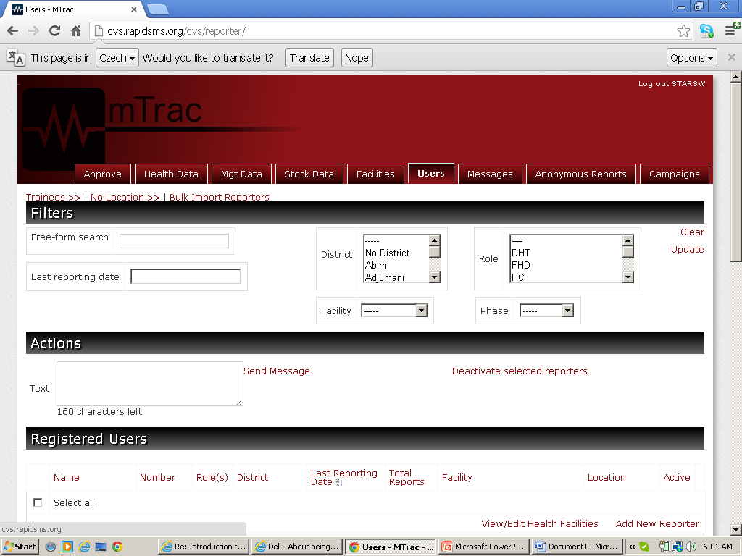
Uganda USG IP Dashboard
Common SMS engine and toll-free shortcode and avoids duplication among IPs
Utilizes existing directories of facilities and health workers
Ability to text messaging to reinforce training, assess knowledge & provide performance support to service providers
Agreement from Districts needed
Notes:
The journey was treacherous at best. From extreme distances to challenging terrain and unpredictable transportation – collecting data the old fashioned way proved to be a time consuming, inefficient and expensive endeavor. This scenario caused health providers to learn about supply shortages only after it had become a relative emergency, hindering efforts to effectively respond to diseases prevalent in the region, such as malaria, HIV, and TB, among others. Under this Cardno Emerging Markets USA, Ltd managed program, HIPS used customized mobile technology to improve data collection, management, and timely reporting at partner sites. Subsequent applications will include commodities tracking and patient adherence

Slide 12

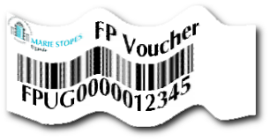
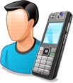

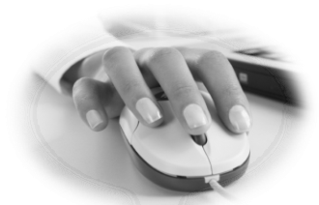


Marie Stopes Voucher Program
BCC sells
to CBD
  Voucher Activation
  Voucher Sale
  Voucher Redemption
Admin
  Cycle of a Voucher Service
CBD sells Voucher to Client
Activation
Client
BlueStarManager
Report of Clients Seen
BlueStar Clinic
Notes:
BlueStar Provider :
Record the full cycle of a voucher service
Capture weekly service statistics
Receive and document stock orders
BCC and CBD:
Sell and buy vouchers
Report on who bought vouchers and when
Regional Coordinator:
Deployment of stock to providers
Keep stock sheets
Set targets for BCCs
Management:
Receives & Analyses real time data
View performance reports on key indicators
View all sales, service numbers
Export user data in excel exportable format

Slide 13
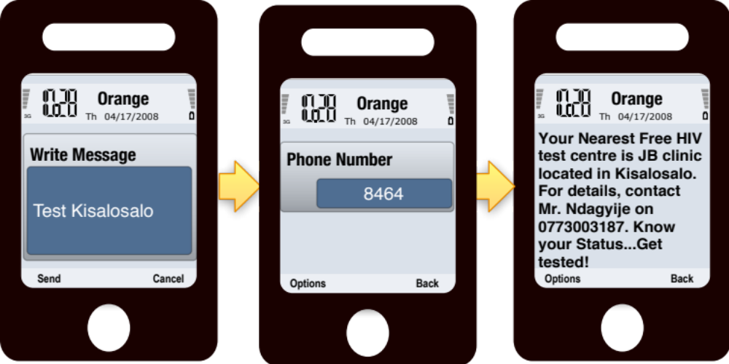
UHMG HIV Testing SMS Locator
Customer goes to create new message and types his location stating with the keyword TEST
Customer send the message to 8464. UHMG’s toll-free short code procured from UCC
The SMS engine, queries for the customer’s location and returns the nearest affiliated Free HIV testing center in real-time
T H E H E A L T H M A R K E T I N G I N I T I A T I V E

Slide 14
Capacity Project – Mobile Reference Directory
Hosted at MOH, database of licensed medical providers updated by professional council
A reply is received with the doctor’s full name, registration number, qualification and license status
Over twelve months, 3,172 inquiries were made on doctors and 457 on private clinics. Two of the doctors were found to be herbalists and the concerned clients were alerted. Two other doctors were arrested and taken to court for illegal practice. Three others are still at large.
Notes:
The journey was treacherous at best. From extreme distances to challenging terrain and unpredictable transportation – collecting data the old fashioned way proved to be a time consuming, inefficient and expensive endeavor. This scenario caused health providers to learn about supply shortages only after it had become a relative emergency, hindering efforts to effectively respond to diseases prevalent in the region, such as malaria, HIV, and TB, among others. Under this Cardno Emerging Markets USA, Ltd managed program, HIPS used customized mobile technology to improve data collection, management, and timely reporting at partner sites. Subsequent applications will include commodities tracking and patient adherence

Slide 15
What can Uganda learn from region on supporting development and roll-out of National e/mHealth systems?
Should funders have separate criteria for mHealth activities in RFA’s?
- How would these criteria differ from overall technical appropriateness/impact criteria
What gaps need to be addressed for USAID IPs once a national roadmap is in place?
- estimating cost?
More info on Uganda eHealth activities in mHealth Compendium v2
Discussion Questions
Notes:
The access.mobile team, led by Founder Kaakpema Yelpaala (KP), an American social entrepreneur of Ghanaian descent, has designed a mobile data collection and analytics system based on an SMS platform to electronically track priority health indicators, monitor stock levels of antiretroviral drugs and support organizations in understanding their data. This m-Health initiative, which uses full keyboard feature phones to send and receive information, has been rapidly scaled up for piloting in 70 health clinics in just three months. It was determined by HIPS that just over 30 of their clinics, mainly urban sites, had sufficient connectivity to send their reports electronically, though the overwhelming majority were not in that position.
But not only is access.mobile working to develop scalable technologies for improved communications in the region, the model of development is one based on local ownership and long-term sustainability. According to KP, “Uganda particularly is a place with a ton of talent in the technology sector. All of our employees in Uganda are from Uganda. They’re trained in mobile technology, computer science, and medicine. They’re the linchpin to our company’s success because they understand the context. They understand how Ugandans think about technology. It’s when you blend a local team like that with a global team like ours – that’s when you get innovation.”

Slide 16
THANK YOU

